Slide 1
Lecture 3- Hobbes

Slide 2

Recap – Conditions of mankind
People by nature have an ongoing desire for power, due to constant insecurity.
There are only finite resources in the state of nature
Perfect equality between people
Perfect liberty – no government or laws.

Slide 3
Natural condition of Mankind
People are by nature largely equal in terms of faculties of body and mind.
From this equality of ability there is the equality of hope that everyone will attain their ends.
But because resources are finite, this equality of desire and ambition leads to conflict and violence
  Lack of sense of security – no way for anyone to secure themselves. No one trusts anyone else.
Three aspects of human nature that create conflict
  Competition – use of violence for gain
  Diffidence (fear) – use of violence in order to protect themselves
  Glory – use of violence to enhance their reputation, to gain reputation for power.

Slide 4
The state of nature: ‘war of everyman against everyman’
“In such condition there is no place for industry, because the fruit thereof is uncertain: and consequently no culture of the earth; no navigation, nor use of the commodities that may be imported by sea; no commodious building; no instruments of moving and removing such things as require much force; no knowledge of the face of the earth; no account of time; no arts; no letters; no society; and which is worst of all, continual fear, and danger of violent death; and the life of man, solitary, poor, nasty, brutish, and short.” (Leviathan ChXIII)

Slide 5
The rights and laws of nature.
The right of nature is the liberty to use your power to defend yourself, to preserve your own life.
First law of nature is to aim for peace where possible, but use violence where necessary.
Second law of nature - people should be prepared to sacrifice as much of their liberty as others are prepared to sacrifice.
  It is only through a sacrifice of some degree of right and liberty that peace can be achieved.
  Paradox of liberty. In order for liberty to be realised, it must be limited: “in the act of submission consisteth both our Obligation and or Liberty”.

Slide 6
The Social Contract
Liberty is renounced either by voluntarily laying it aside or (more commonly) by transferring it onto another.
Therefore idea of authority based on consent.
In transferring our liberty so we are placed under obligation, bound to that other.
Once consent is given, it is permanent, we cannot withdraw it – because this risks returning to the state of nature
This is a symbolic rather than actual bond or covenant.
Hobbes wants to show that a contract has been freely entered into – just like a legal contract which involve a conscious exchange.
But unlike a normal legal contract, consent in the social contract is permanent and fixed..
At the same time, because one can only transfer or renounce one’s rights because of some good or benefit (security) that would come from this, there are certain rights which cannot be renounced – which are not transferable: the right to self-protection, the right to protect oneself from others trying to injure or imprison you > basic right of self-preservation.

Slide 7
Other laws of nature
Law of gratitude
Law of complaisance
Law of pardon
Law against revenge
Law against declarations of hatred or contempt for another
Law of equality
Man must retain certain rights
Law of impartial judgement.
No person can be his own judge
One simple formula: Do not do unto others what you would not have done unto you (opposite of the Biblical formula – do unto others)

Slide 8
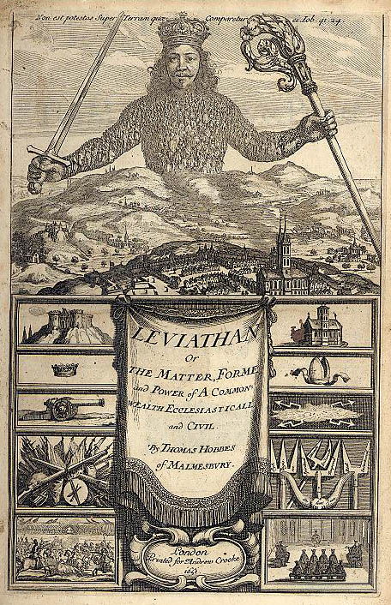
The Commonwealth

